Slide 1
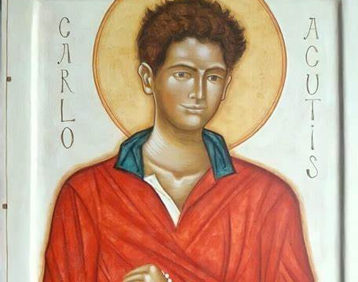
Blessed St Carlo Acutis
By Rachael, Guillaume, Ethan & Aaron

Slide 2
Who was Carlos Acutis?
Carlos Acutis was born in London but later grew up and was raised in Milan Italy where he was raised up in a roman catholic household.
He was a practicing catholic and even became an alter server.
Carlos died a young boy at the age of 15 after a brief battle with leukemia (2006)

Slide 3
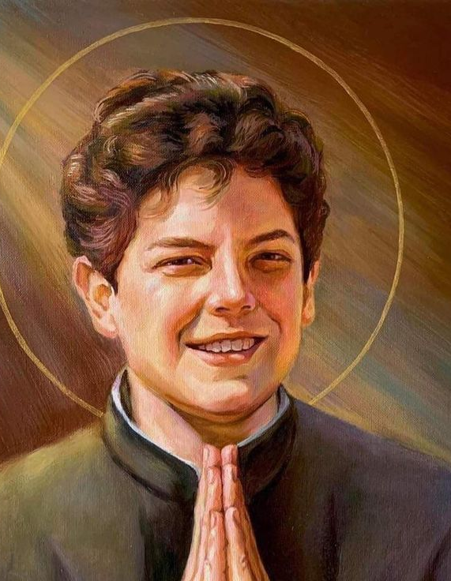
His Passions:
“As a little boy, especially after his First Communion, he never missed his daily appointment with the Holy Mass and the Rosary, followed by a moment of Eucharistic adoration,
Today Carlos is loved around the world for his example of holiness and his passion for communications and technology.
Throughout his life Carlo had a great concern for his friends often inviting those being treated poorly or going through difficult situations to his home for support.
Some were dealing with divorce at home or being bullied due to disabilities and this would be a time for him to not only try and give reassurance and strength but try to spread the load of Jesus and the wonders he has done to inspire not only his friends but thousands of people through his testimony and faith.

Slide 4
What did he do?
According to his mother – Carlos was a very bright kid. "He could make things from ordinary to extra ordinary"
From a young age he has always had an interest for technology.
He was also very good at filming, making films and even using computers
He decided to make a web-based resource where people could learn about the faith, this included a list of confirmed eucharistic miracles and Marian apparitions.
Carlo wanted to utilize technology and his website to evangelize. He was inspired by Blessed Giacomo Alberione’s initiatives to use the media to proclaim the Gospel
Even after his passing, the friends and family of Carlos continue to keep going on spreading the word of God through his website.

Slide 5
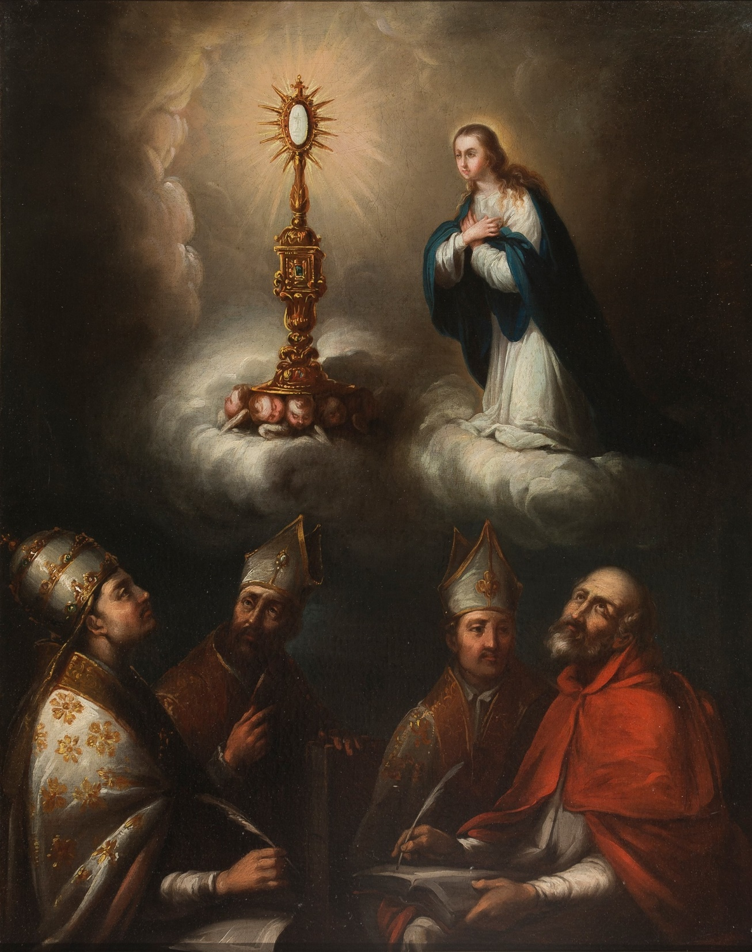
Some Quotes from Blessed Carlos Acutis: His story acts to inspire us and can help to motivate us in becoming better Catholics.
“I am happy to die because I have lived my life without wasting a minute on those things that do not, please God.” “The Eucharist is the highway to heaven.”
“The Virgin Mary is the only woman in my life.”
“All people are born as originals, but many live as photocopies.”
“The only thing we have to ask God for, in prayer, is the desire to be holy.”
“Our goal must be infinite, not the finite.”
“By standing before the Eucharistic Christ, we become holy.”

Slide 6
Where can you see him?
Acutis’ tomb is located in Assisi’s Sanctuary of the Renunciation, a part of the Church of St. Mary Major.
The sanctuary is located on the spot where a young St. Francis of Assisi is said to have cast off his rich clothes in favour of a poor habit.

Slide 7
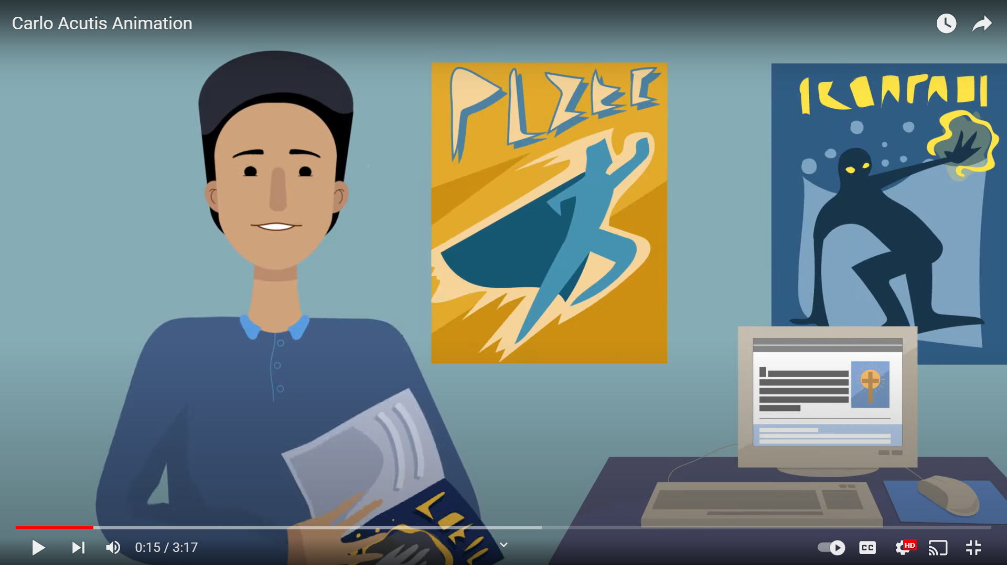
Finally, we have a short video for you to watch:
https://youtu.be/IZ0p_3o-uMc?si=FrVEG2ytTmwEw2gx

